Slide 1

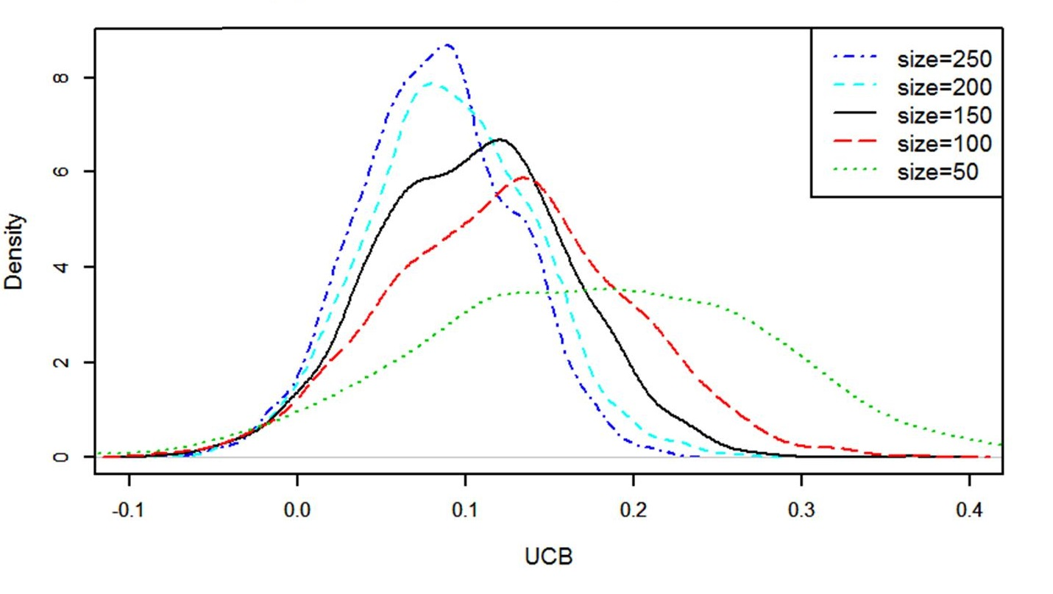
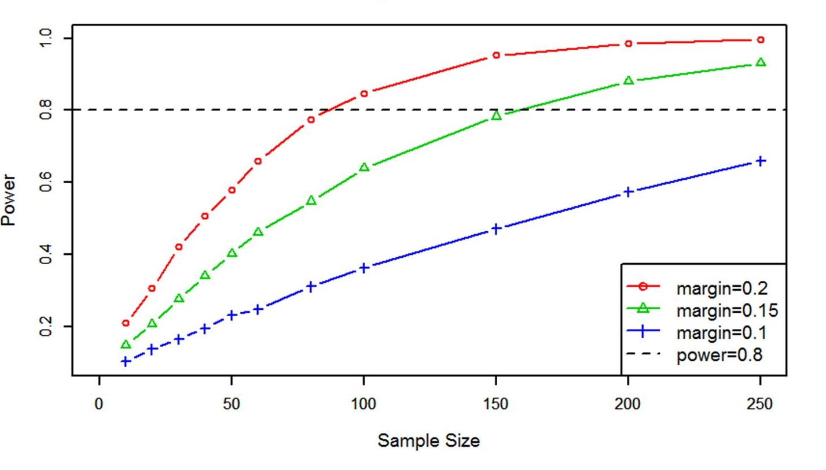
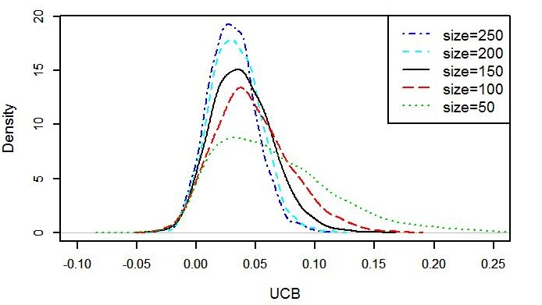
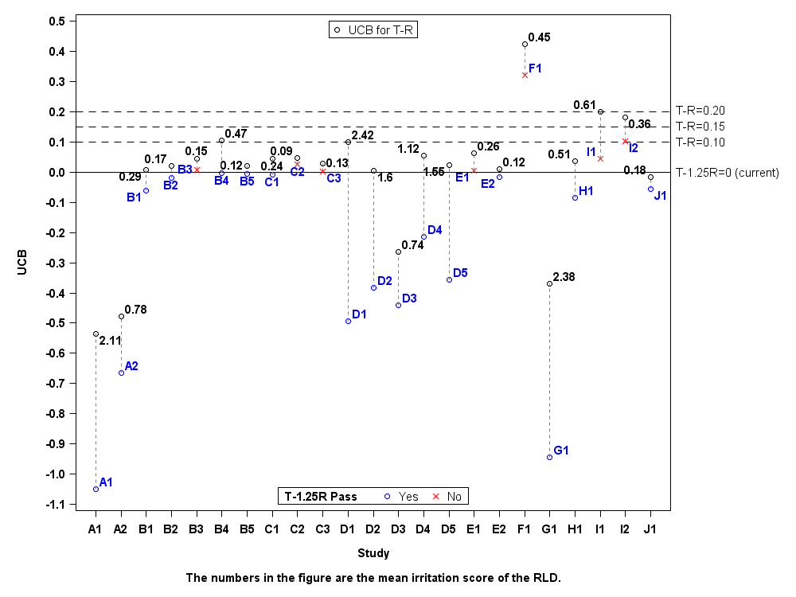
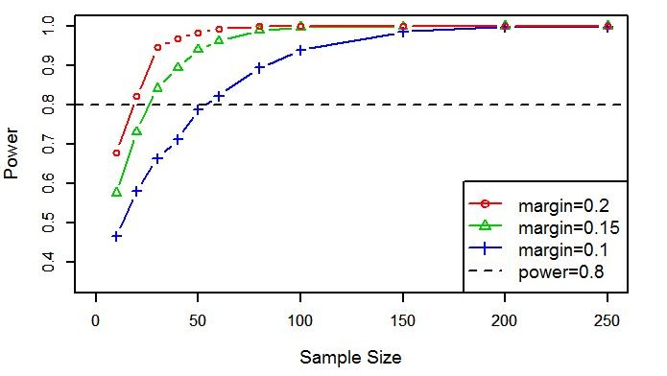

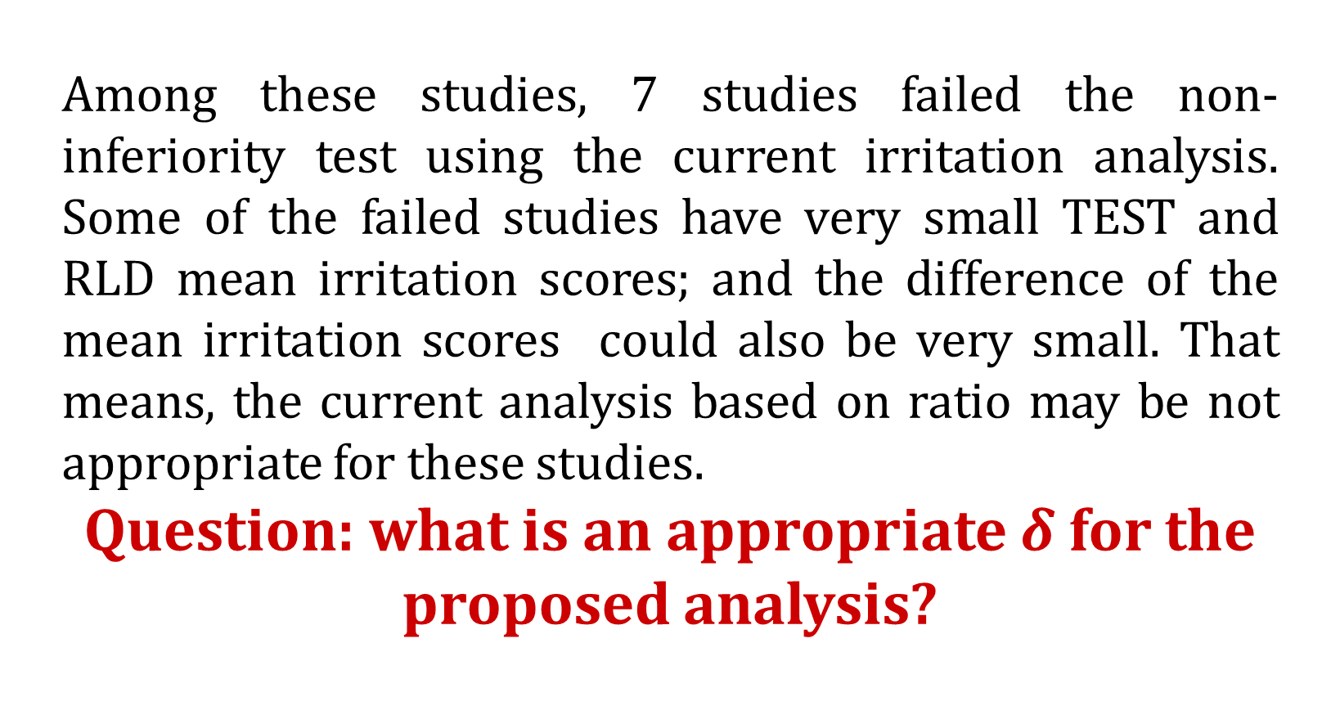
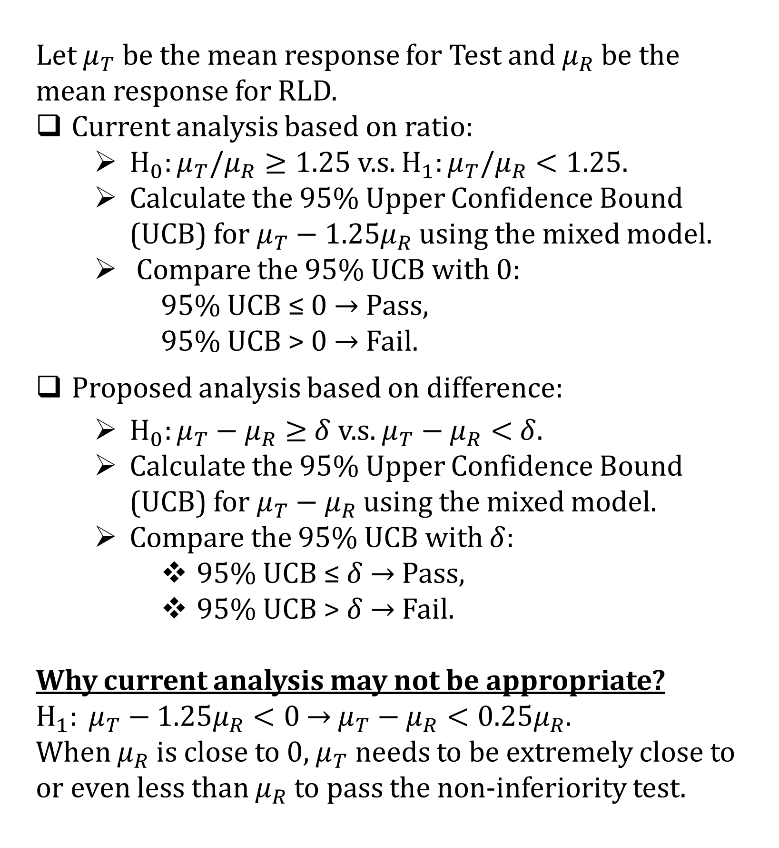

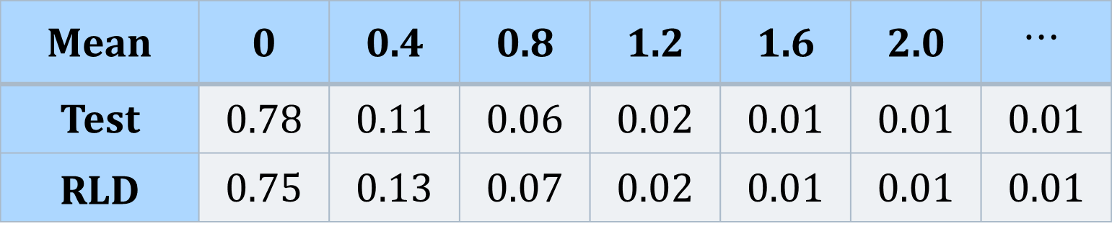
Statistical Considerations in Irritation Study for Transdermal Delivery System Drug Products
Mengdie Yuan, Ph.D., Julia Luan, Ph.D., Stella Grosser, Ph.D.
Introduction
Statistical Methods
Simulation Studies
Simulation Studies
Two types of studies are recommended for Transdermal Delivery System (TDS) in support of Abbreviated New Drug Application (ANDA):
Bioequivalence (BE) with pharmacokinetic (PK) endpoints study
Skin irritation, sensitization, and adhesion study
Adhesion study
Irritation/sensitization study
The second type of study needs to show that the test product (TEST) is statistically non-inferior compared to the Reference Listed Drug (RLD), i.e., Test must:
adhere at least as well as the RLD
be no more irritating than the RLD
be no more sensitizing than the RLD
Regarding the adhesion study, FDA recently issued a new draft guidance on “Assessing Adhesion with Transdermal Delivery Systems and Topical Patches for ANDAs” in June 2016.
Motivation:
The old recommended statistical analysis for adhesion study and the current recommended statistical analysis for irritation study may both have too large a chance of failing good generic products. Therefore in the new draft guidance for adhesion study, the recommended statistical analysis was revised to solve the problem. Currently, a new working group on irritation study has been formed by the Division of Clinical Review (DCR) in Office of Generic Drug (OGD), and will also revise the recommended statistical analysis in the new draft guidance on assessing the irritation and sensitization potentials of TDS and Topical Patches for ANDAs.
Irritation Study Design:
TEST and RLD patches are applied simultaneously to each subject at the different skin sites (e.g. left arm, right arm), with sequential applications to the same skin sites every certain period of time (depending on the drug product), for a total of 21 consecutive days. Scores for dermal response (ranging from 0 to 7) and other effects (ranging from 0 to 3) are recorded by a trained evaluator blinded to treatment allocation after each patch was removed before the next patch application or end of the study. The irritation score is calculated as the total score for dermal response and other effects.
Irritation Study Primary Endpoint:
Mean Irritation Score: for each subject and each TDS, sum of the irritation scores observed at each time points divided by the total number of observations.
Let $μ_{T}$ be the mean response for Test and $μ_{R}$be the mean response for RLD.
Current analysis based on ratio:
$H_{0}:μ_{T}/μ_{R}≥1.25$ v.s. $H_{1}:μ_{T}/μ_{R}<1.25.$
Calculate the 95% Upper Confidence Bound (UCB) for $μ_{T}−1.25μ_{R}$ using the mixed model.
Compare the 95% UCB with $0$:
95% UCB ≤ $0$ → Pass,
95% UCB > $0$ → Fail.
Proposed analysis based on difference:
$H_{0}:μ_{T}−μ_{R}≥$ $δ$ v.s. $μ_{T}−μ_{R}<$ $δ$.
Calculate the 95% Upper Confidence Bound (UCB) for $μ_{T}−μ_{R}$ using the mixed model.
Compare the 95% UCB with $δ$:
95% UCB ≤ $δ$ → Pass,
95% UCB > $δ$ → Fail.
Why current analysis may not be appropriate?
$H_{1}: μ_{T}−1.25μ_{R}<0$ → $μ_{T}−μ_{R}<0.25μ_{R}$.
When $μ_{R}$ is close to 0, $μ_{T}$ needs to be extremely close to or even less than $μ_{R}$ to pass the non-inferiority test.
Date Generation
Ibrahim et al. (2011): Generating correlated ordinal data using R and SAS IML.
Generate data based on multinomial distribution
Need to set the marginal probabilities and the Goodman–Kruskal correlations.
For example, correlation=0.9
Simulation Scenarios
TEST and RLD with Equal Marginal Distribution
TEST and RLD with Different Marginal Distributions
Type I Error Rate Investigation
Margin Studied
$δ$=0.1, 0.15 and 0.2
1. Equal Marginal Distribution
In this scenario, we used the same marginal distribution for TEST and RLD mean irritation scores. TEST and RLD: Mean=0.52, SD=0.61. Correlation=0.91.
Table: Power vs Sample Size
2. Different Marginal Distributions
In this scenario, the simulated TEST distribution was different from but considered to be acceptably close to the RLD distribution, i.e., the irritation potential of the TEST is non-inferior to that of the RLD.
TEST: Mean=2.43, SD=0.88. RLD: Mean=2.42, SD=0.77. Correlation: 0.46.
Table: Power vs Sample Size
3. Type I Error Rate Investigation
In this scenario, a case with observed difference of the mean irritation score between TEST and RLD 0.15 was investigated under $δ$ = 0.15. Simulation studies based on observed TEST and RLD distributions with a range of sample sizes from 50 to 250 showed that the type I error rates were well controlled under level 0.05.
Mean | 0 | 0.4 | 0.8 | 1.2 | 1.6 | 2.0 | $$⋯$$
Test | 0.78 | 0.11 | 0.06 | 0.02 | 0.01 | 0.01 | 0.01
RLD | 0.75 | 0.13 | 0.07 | 0.02 | 0.01 | 0.01 | 0.01
Revisit of Selected Submitted Irritation Studies
Reanalyzed selected submitted irritation studies using both the current analysis and the proposed analysis.
Sample Size | Margin 0.1 | Margin 0.15 | Margin 0.2
20 | 0.14 | 0.21 | 0.31
40 | 0.20 | 0.34 | 0.51
60 | 0.25 | 0.46 | 0.66
80 | 0.31 | 0.55 | 0.78
100 | 0.36 | 0.64 | 0.85
150 | 0.47 | 0.74 | 0.95
200 | 0.57 | 0.88 | 0.98
250 | 0.66 | 0.93 | 1.00
Sample Size | Margin 0.1 | Margin 0.15 | Margin 0.2
10 | 0.46 | 0.58 | 0.68
20 | 0.58 | 0.73 | 0.82
30 | 0.66 | 0.84 | 0.95
40 | 0.71 | 0.89 | 0.97
50 | 0.79 | 0.94 | 0.98
60 | 0.82 | 0.96 | 0.99
80 | 0.89 | 0.99 | 1.00
100 | 0.94 | 1.00 | 1.00
150 | 0.96 | 1.00 | 1.00
200 | 0.99 | 1.00 | 1.00
250 | 1.00 | 1.00 | 1.00
Among these studies, 7 studies failed the non-inferiority test using the current irritation analysis. Some of the failed studies have very small TEST and RLD mean irritation scores; and the difference of the mean irritation scores could also be very small. That means, the current analysis based on ratio may be not appropriate for these studies.
Question: what is an appropriate $δ$ for the proposed analysis?
Summary
The results of the simulation studies based on real cases and clinical judgment of acceptable or not can help us determine the appropriate margin.
Other cases have also been studied for both scenarios. The results are similar and as expected.
In addition, the power decreases as Mean and SD increase.
The choice of margin needs further investigation and discussion with the clinical team.

